Slide 1
COMPUTER VISION REPORT 1 PRESENTATION
BRICE Chloe – 9IE24001M

Slide 2
CONTENT
Project structure : | What are the steps and how the code is implemented
Epipolar Geometry : | Results with same plane and not same plane
Extra points: | Additional computation with OpenCV
Notes:
Process and results of stereo project

Slide 3
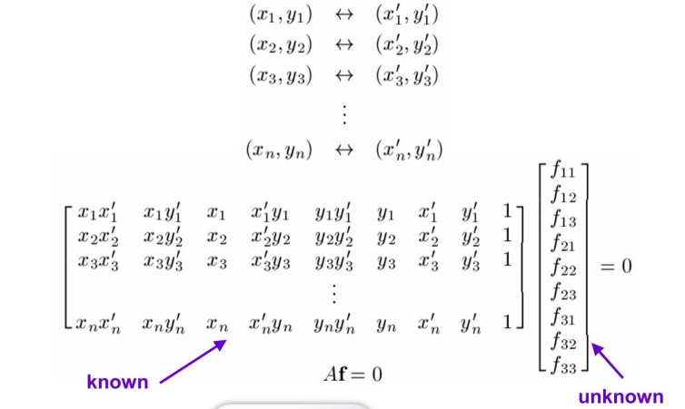
PROJECT STRUCTURE / 8-PTS ALGORITHM
Aim : compute the fundamental matrix, and find camera parameters.
Used : python, images, .txt file and OpenCV on C++
8-points algorithm :
- construct matrix A
- matrix decomposition
- find F
Notes:
Won’t go implemented details as we all went through this
Basically ; run python, with feature points parsed from txt and opencv with c++
Will present the results of my images
8-points algorithm

Slide 4
RESULTS OF SAME PLANE

Slide 5
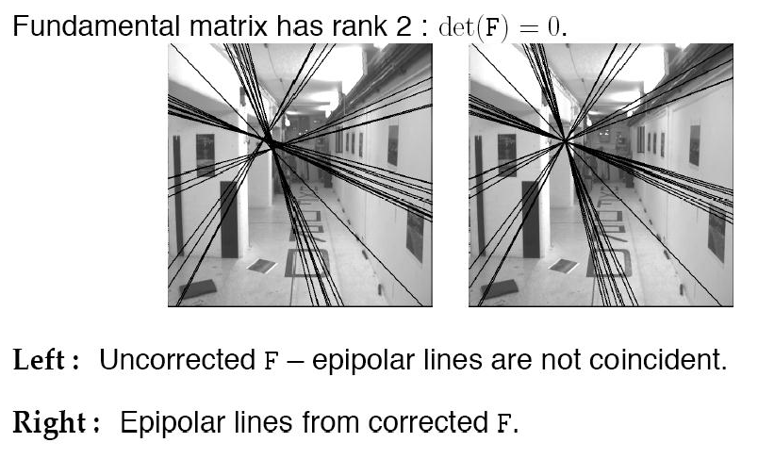
F MATRIX COMPUTATION
F = [[-4.73740750e-07 -1.13802302e-05 3.35809641e-03]
[ 1.22939146e-05 1.07187547e-06 -6.63373183e-03]
[-4.24614748e-03 4.34904160e-03 9.99953885e-01]]
- - - - - Question A-3 : Verification of F - - - - -
----------
The eigenvalues of F are : [9.99910772e-01 2.09169242e-19 4.37114951e-05]
The rank of F is : 2
----------
Epipolar Geometry and Stereo Vision Computer Vision CS 543 / ECE 549 University of Illinois Derek Hoiem ©
Notes:
Ensure that rank is too otherwise matrix would be invertible → wont be coincident

Slide 6
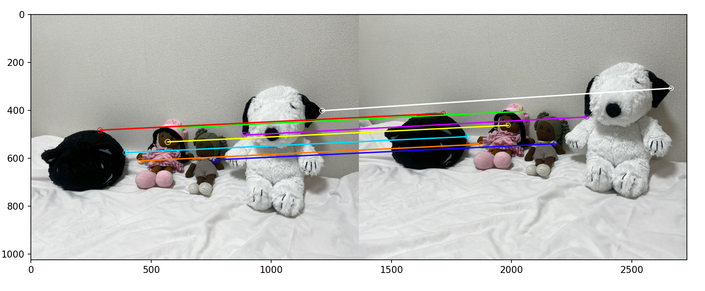
CONNECTING LINES
Notes:
Ask for participation of all the plush toys of our flat-share → can ensure were aggering

Slide 7
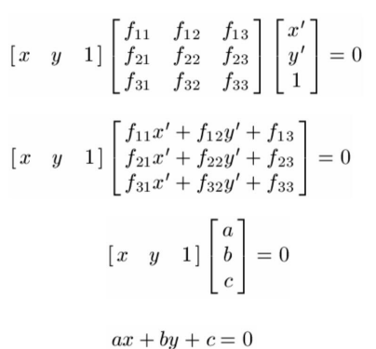
EPIPOLAR LINES
Example :
Img 1 : Point 0 : -0.001507747939062417 x + -0.0018881771519421936 y + 1.3099564465851883 = 0
Img 2 : Point 0 : 0.0015549021949291062 x + 0.0015778709089195515 y + -1.233648725800892 = 0

Slide 8
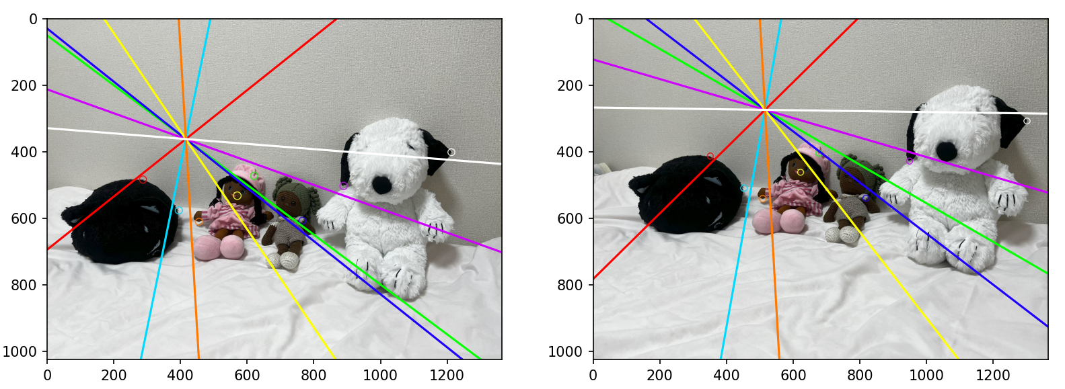
EPIPOLAR LINES
Notes:
Not very satisfactory, but still relevant
line converge to the same point However expected intersect outside
just moved slightly from left to right.

Slide 9
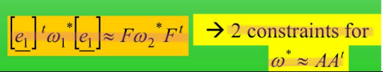
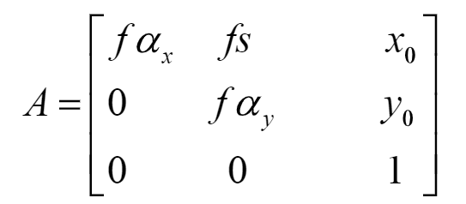
CAMERA PARAMETERS
- focal length of the camera, image center
- need epipoles
- Kruppa equations with the image of the absolute dual quadric

Slide 10
CAMERA PARAMETERS
Results of epipoles computation:
- - - - - Question B-7 : Intrinsic Camera Parameters - - - - -
Would you like to find intrinsic camera parameters with Kruppa equations ?
[y/n] : y
Left epipole: [416.19925193 361.42418181 1. ]
Right epipole: [515.73919625 273.61219166 1. ]
Left epipole (matrix form): [[ 0. 1. 361.42418181]
[ 1. 0. -416.19925193]
[-361.42418181 416.19925193 0. ]]
Right epipole (matrix form): [[ 0. 1. 273.61219166]
[ 1. 0. -515.73919625]
[-273.61219166 515.73919625 0. ]]

Slide 11
RESULTS OF NOT SAME PLANE

Slide 12
F MATRIX COMPUTATION
F = [[ 3.23484509e-07 -8.24416313e-06 3.16293391e-03]
[ 2.18257454e-05 -2.78169850e-06 4.09953385e-02]
[-7.12409269e-03 -4.52513760e-02 9.98103671e-01]]
- - - - - Question A-3 : Verification of F - - - - -
----------
The eigenvalues of F are : [9.96218920e-01 3.09784999e-19 1.88229224e-03]
The rank of F is : 2
----------

Slide 13
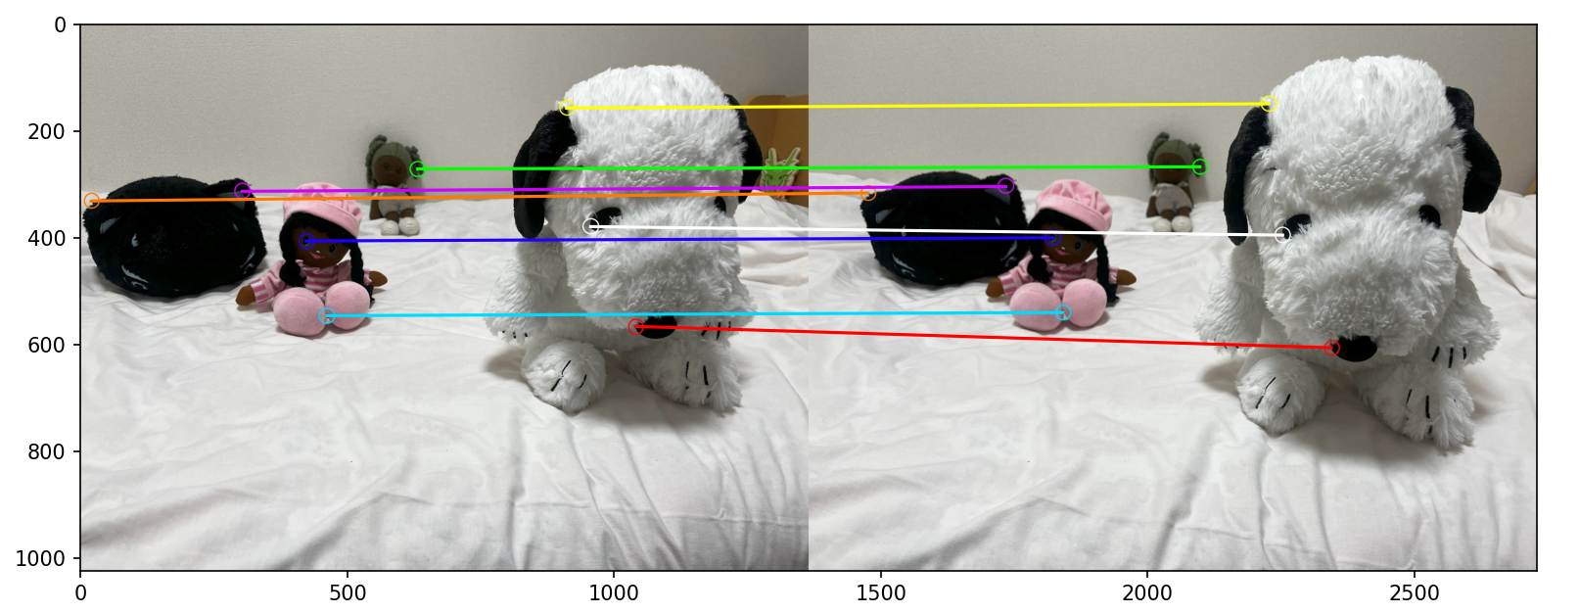
CONNECTING LINES

Slide 14
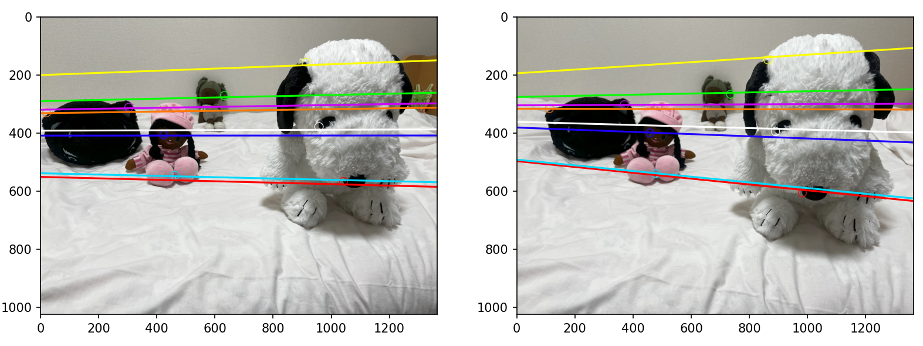
EPIPOLAR LINES
Notes:
different planes allows more information geometry camera renders it. If we follow where the epipolar lines are converging for image 2 (right), we can see where the image 1 (left) was taken. It isn’t really the case with image 1, where it looks more just like a translation of the camera.

Slide 15
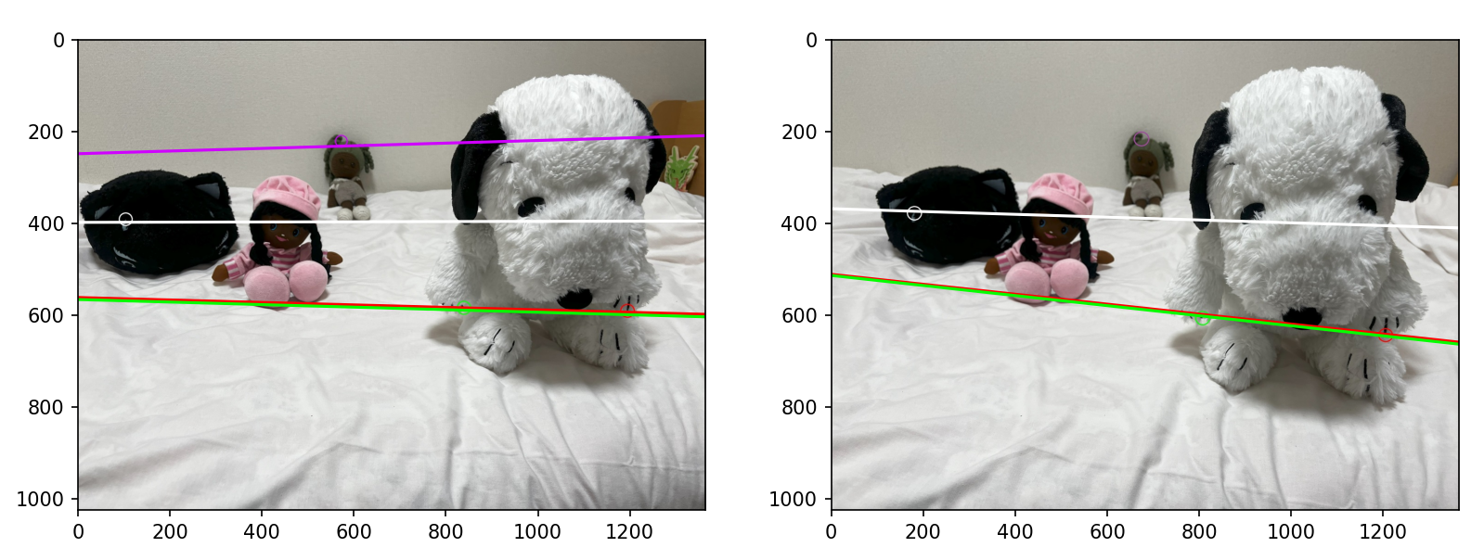
NOT COMPUTED POINTS

Slide 16
EXTRA POINTS OPENCV
- OpenCV algorithms
- Feature points and match the points
- Max number of points
- thresold
ALGO | PTS/THRESOLD | REMAINING
ORB | 200/60 | 107
AKAZE | 200/60 | 28
AKAZE | 300/60 | 50

Slide 17
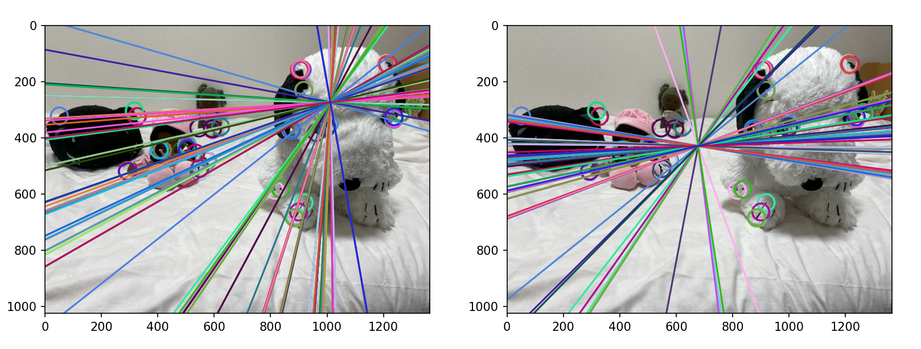
EXTRA POINTS OPENCV ORB
Remaining points : 107
Notes:
lot of points remaining, gathered to the same areast image 2 better results : epipolar lines are closer to corresponding points… However we can’t exploit so much those results.

Slide 18
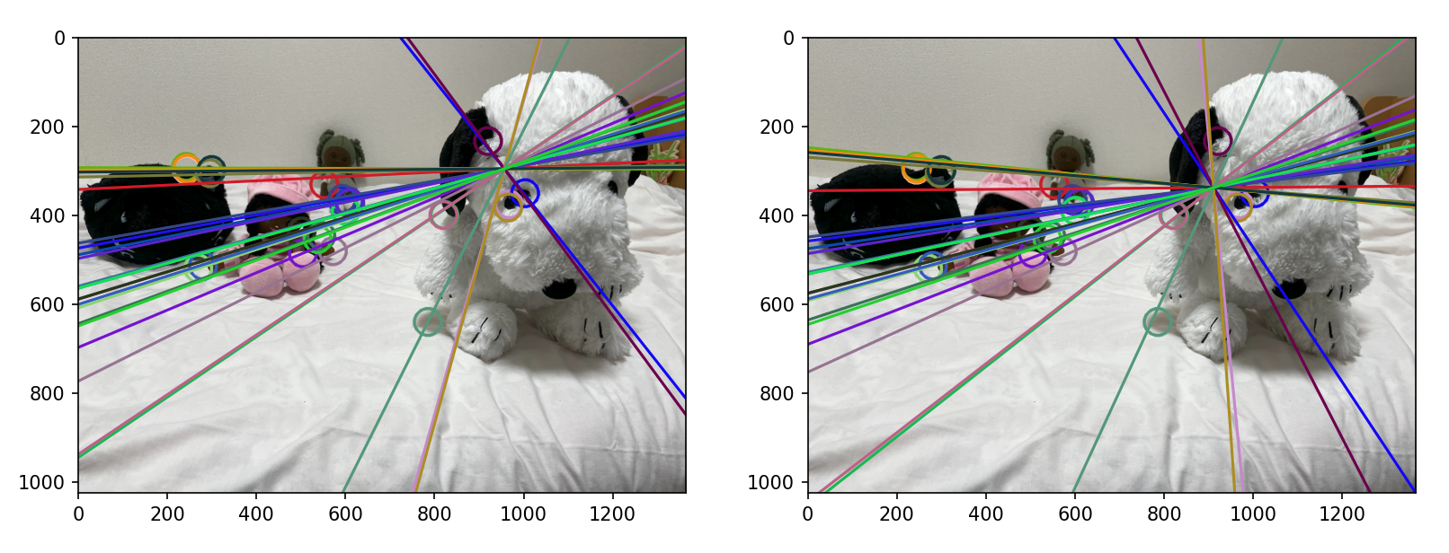
EXTRA POINTS OPENCV AKAZE
Remaining points : 28

Slide 19
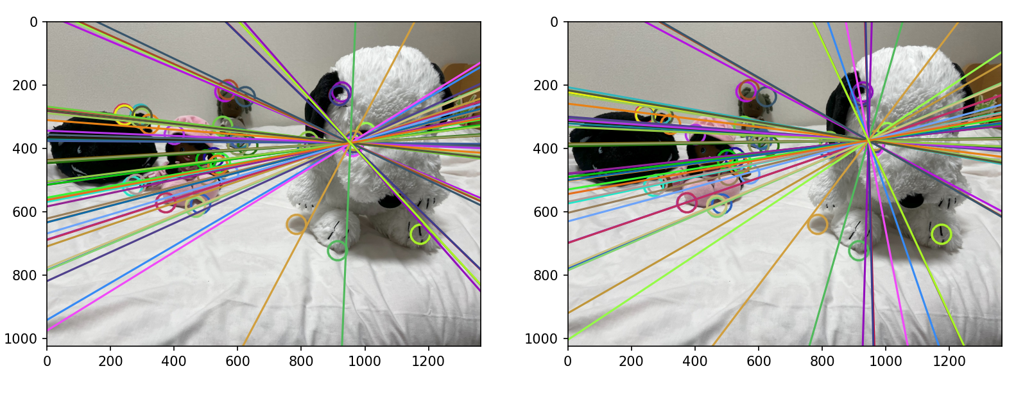
EXTRA POINTS OPENCV AKAZE
Remaining points : 50
Notes:
It is even more noticeable with 50 remaining points.

Slide 20



AKAZE / ORB
ORB : FAST method for the keypoints
AKAZE more specialized : different scales and points of view
ORB ; binary descriptors / AKAZE ; + gradient image to be more precise.
Notes:
main differences between AKAZE and ORB?
In fact, ORB can miss details not render the depth correctly.
AKAZE convenient in our case. AKAZE’s feature descriptors relevant dealing with the change of planes, angles… ratio test, and ORB being especially fast, AKAZE is still more relevant in our case of study.

Slide 21
CONCLUSION
Not same plane more accurate
In general fits the reality but still inequal
Many sources of approximation : post-process of the camera, algorithm sensitive to noise, normalization…
Notes:
more controlled movement between the two images, more suitable images with less noise, normalization…
However even with homemade pictures we have been able to analyze the epipolar geometry and work on stereo basics.

